Slide 1

Operating Systems Design​ Session 21, 40: The boot loader: Assembly bootstrap, C bootstrap
19CS2106S​
© 2020 KL University

Slide 2
Booting

Slide 3
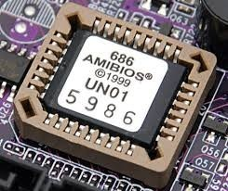
Powering up : Reset
Physical address = Code Segment + Instruction Pointer
= (CS << 4) + IP = 0xffff0
first instruction fetched from location 0xffff0
Power on Reset
Does the following
Power on self test
Initialize video card and other devices
Display BIOS screen
Perform brief memory test
Set DRAM memory parameters
Configure Plug & Play devices
Assign resources (DMA channels & IRQs)
Identify the boot device
Read sector 0 from boot device into memory location 0x7c00
Jumps to 0x7c00
Every register initialized to 0 except
CS=0xf000, IP=0xfff0
0x00100000 (1 MB)
BIOS ROM
0x000F0000 (960 KB)

Slide 4
Powering up : MBR
Sector 0 in the disk called Master Boot Record (MBR)
Contains code that boots the OS or another boot loader
Copied from disk to RAM (@0x7c00) by BIOS and then begins to execute
Size 512 bytes
446 bytes bootable code
64 bytes disk partition information (16 bytes per partition) 2 bytes signature
Typically, MBR code looks through partition table and loads the bootloader (such as Linux or Windows) or, it may directly load the OS
4

Slide 5
Powering Up : bootloader
May also allow the user to select which OS to load (eg. Windows or Linux)
Disable interrupts
Switch from real mode to protected mode
Read operating system from disk
•
Name of the bootloader | Description
Bootmgr | Microsoft systems since Windows Vista and Windows Server 2008
NT loader (NTLDR) | Microsoft systems until Windows XP and Windows Server 2003
barebox | embedded systems in printers, cameras, cars, airplanes, and more
boot.efi | EFI bootloader that has been used in Mac devices since 2006
BootX | former bootloader for Mac operating systems
Grand Unified Bootloader (GRUB) | free boot program for Unix-like operating systems such as Linux
ARM Core Bootloader | bootloader for microcontrollers (used in iPhones among others)
OpenBIOS | free, portable boot manager under a GNU-GPL license
5

Slide 6
Booting in XV6

Slide 7
bootasm.s
BOOTLOADER
bootasm.S and bootmain.c is the bootloader.
It should be stored in the first sector of the disk.
The 2nd sector onward holds the kernel image in ELF format
control starts in bootasm.S -- which sets up protected mode, and a stack. then calls bootmain()
bootmain() takes over, reads in the kernel image.
bootmain.c

Slide 8
2GB + 4 MB
2GB
Page Table
First Address Space
bootasm.s
4 MB
0
4 MB
0
bootmain.c
Virtual Memory
Physical Memory
entry
entrypgdir
paging and stack
main()
Defines a Page and creates a page directory entrypgdir
Virtual to Physical address Mapping is done
Turns on paging and set stack pointer for kernel
Kernel execution starts

Slide 9
Powering Up : bootloader XV6
Xv6 uses the conventional hard drive boot mechanism, with a sector size of 512 bytes.
2 Parts of boot loader
One assembly language source file bootasm.S
Switches the processor from real mode(16 Bit) to 32-bit protected mode
Disables interrupts
Enable A20 line
Load GDT
Invoke bootmain.c
One C source file, bootmain.c.
The boot loader reads the kernel from the hard disk by directly accessing the IDE disk device registers via the x86's special I/O instructions.
•
9

Slide 10
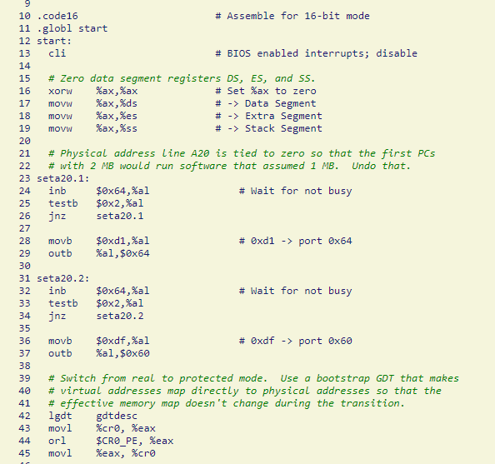
XV6 – bootasm.S
zero previous data segment registers and other related registers.
•
Then we ENABLE A20.
As we are in real mode, the ability of addressing is 20-bit address.
To enable 32-bit addressing. We need to send 2 binary code to the computer to enable A20.
In real mode, CS and IP is combined to find the physical address, which we call this is segment address.
Notes:
gdt

Slide 11
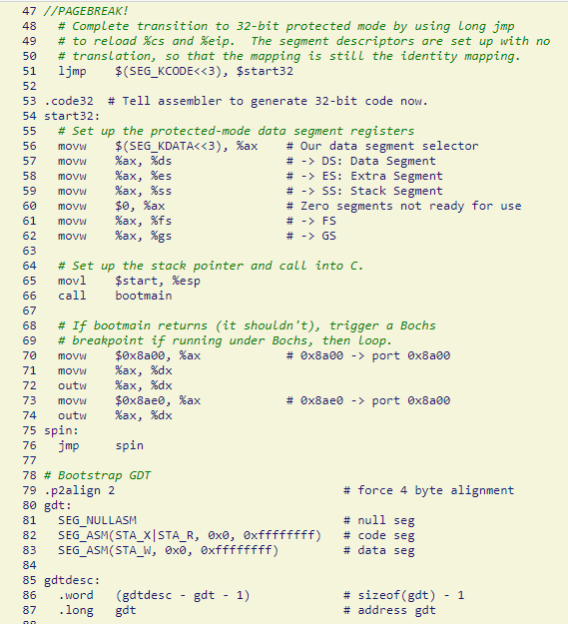
XV6 – bootasm.S
Then let’s go to the 32-bit world.
•
we set %esp points to the address of $start
Call bootmain.c
It should not return from bootmain
If returns it tries to debug
It is just a temporary GDT used for bootloader.
Notes:
gdt

Slide 12
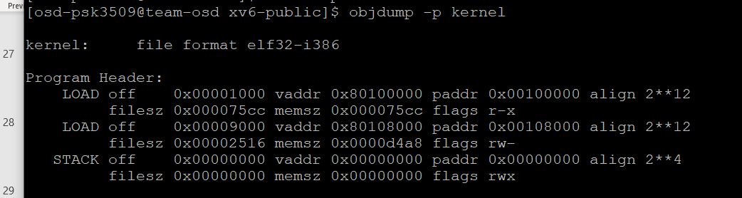
XV6 – bootmain.c
0905 struct elfhdr {
0906 uint magic;
0907 uchar elf[12];
0908 ushort type;
0909 ushort machine;
0910 uint version;
0911 uint entry;
0912 uint phoff;
0913 uint shoff;
0914 uint flags;
0915 ushort ehsize;
0916 ushort phentsize;
0917 ushort phnum;
0918 ushort shentsize;
0919 ushort shnum;
0920 ushort shstrndx;
0921 };
0924 struct proghdr {
0925 uint type;
0926 uint off;
0927 uint vaddr;
0928 uint paddr;
0929 uint filesz;
0930 uint memsz;
0931 uint flags;
0932 uint align;
0933 };
Kernel will be in ELF (Executable and Linkable Format)
The ELF header contains all of the relevant information required to load an ELF executable
Read the ELF Header located at the very beginning.

Slide 13
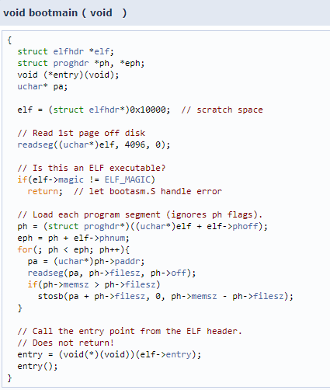
XV6 – bootmain.c
Verify that the file starts with the ELF magic number (4 bytes)
Read the ELF executable's program headers.
Parse the program headers to determine the number of program segments that must be loaded.
Copy the segment data from the file offset specified by the p_offset member to the virtual memory address specified by the p_vaddr member.
The size of the segment in the file is contained in the p_filesz member.
The p_memsz member specifies the size the segment occupies in memory.
If the p_filesz and p_memsz members differ, this indicates that the segment is padded with zeros.

Slide 14

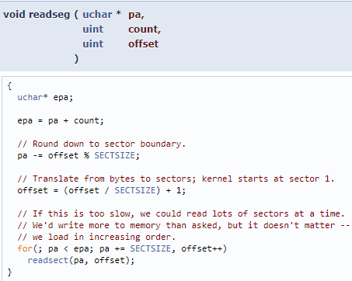
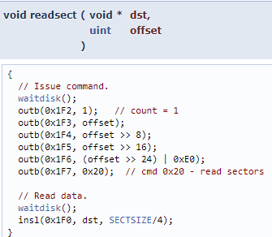
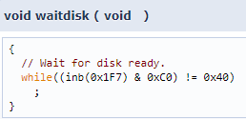
XV6 – bootmain.c
// store value of '1' into the number of sectors register
// set the sector offset registers
// Set ready register
//insl: write buffer gets written 128 times from the register via CPU.

Slide 15
2GB + 4 MB
2GB
enrypgdir
First Address Space
bootasm.s
4 MB
0
4 MB
0
bootmain.c
Virtual Memory
Physical Memory
entry
entrypgdir
paging and stack
main()
Defines a Page and creates a page directory entrypgdir
Virtual to Physical address Mapping is done
Turns on paging and set stack pointer for kernel
Kernel execution starts

